Slide 1
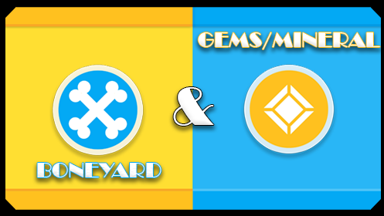

Minerals & Boneyard
Lindsey Berkowitz
Piero Salini
Savion Mercedes

Slide 2
GOAL
Our app was designed to help showcase and inform museum visitors on a variety of desired facts or information that weren’t already present or available in their respective exhibits.
Using hopefully appealing graphics, icons and collected information, we aspired to transfer previously missing knowledge to the hungry minds of the museum-goers; in order to encourage further appreciation or interest in a frequently forgotten or bypassed area within the museum.

Slide 3
CONTENT
The addition of information such as general location be it in time or place, basic description, and just interesting or cool facts.
Visual inspiration as drawn from a multitude of well received exemplary galleries or just from existing principles of design.
A simple quiz game on the variety of gems and minerals.

Slide 4
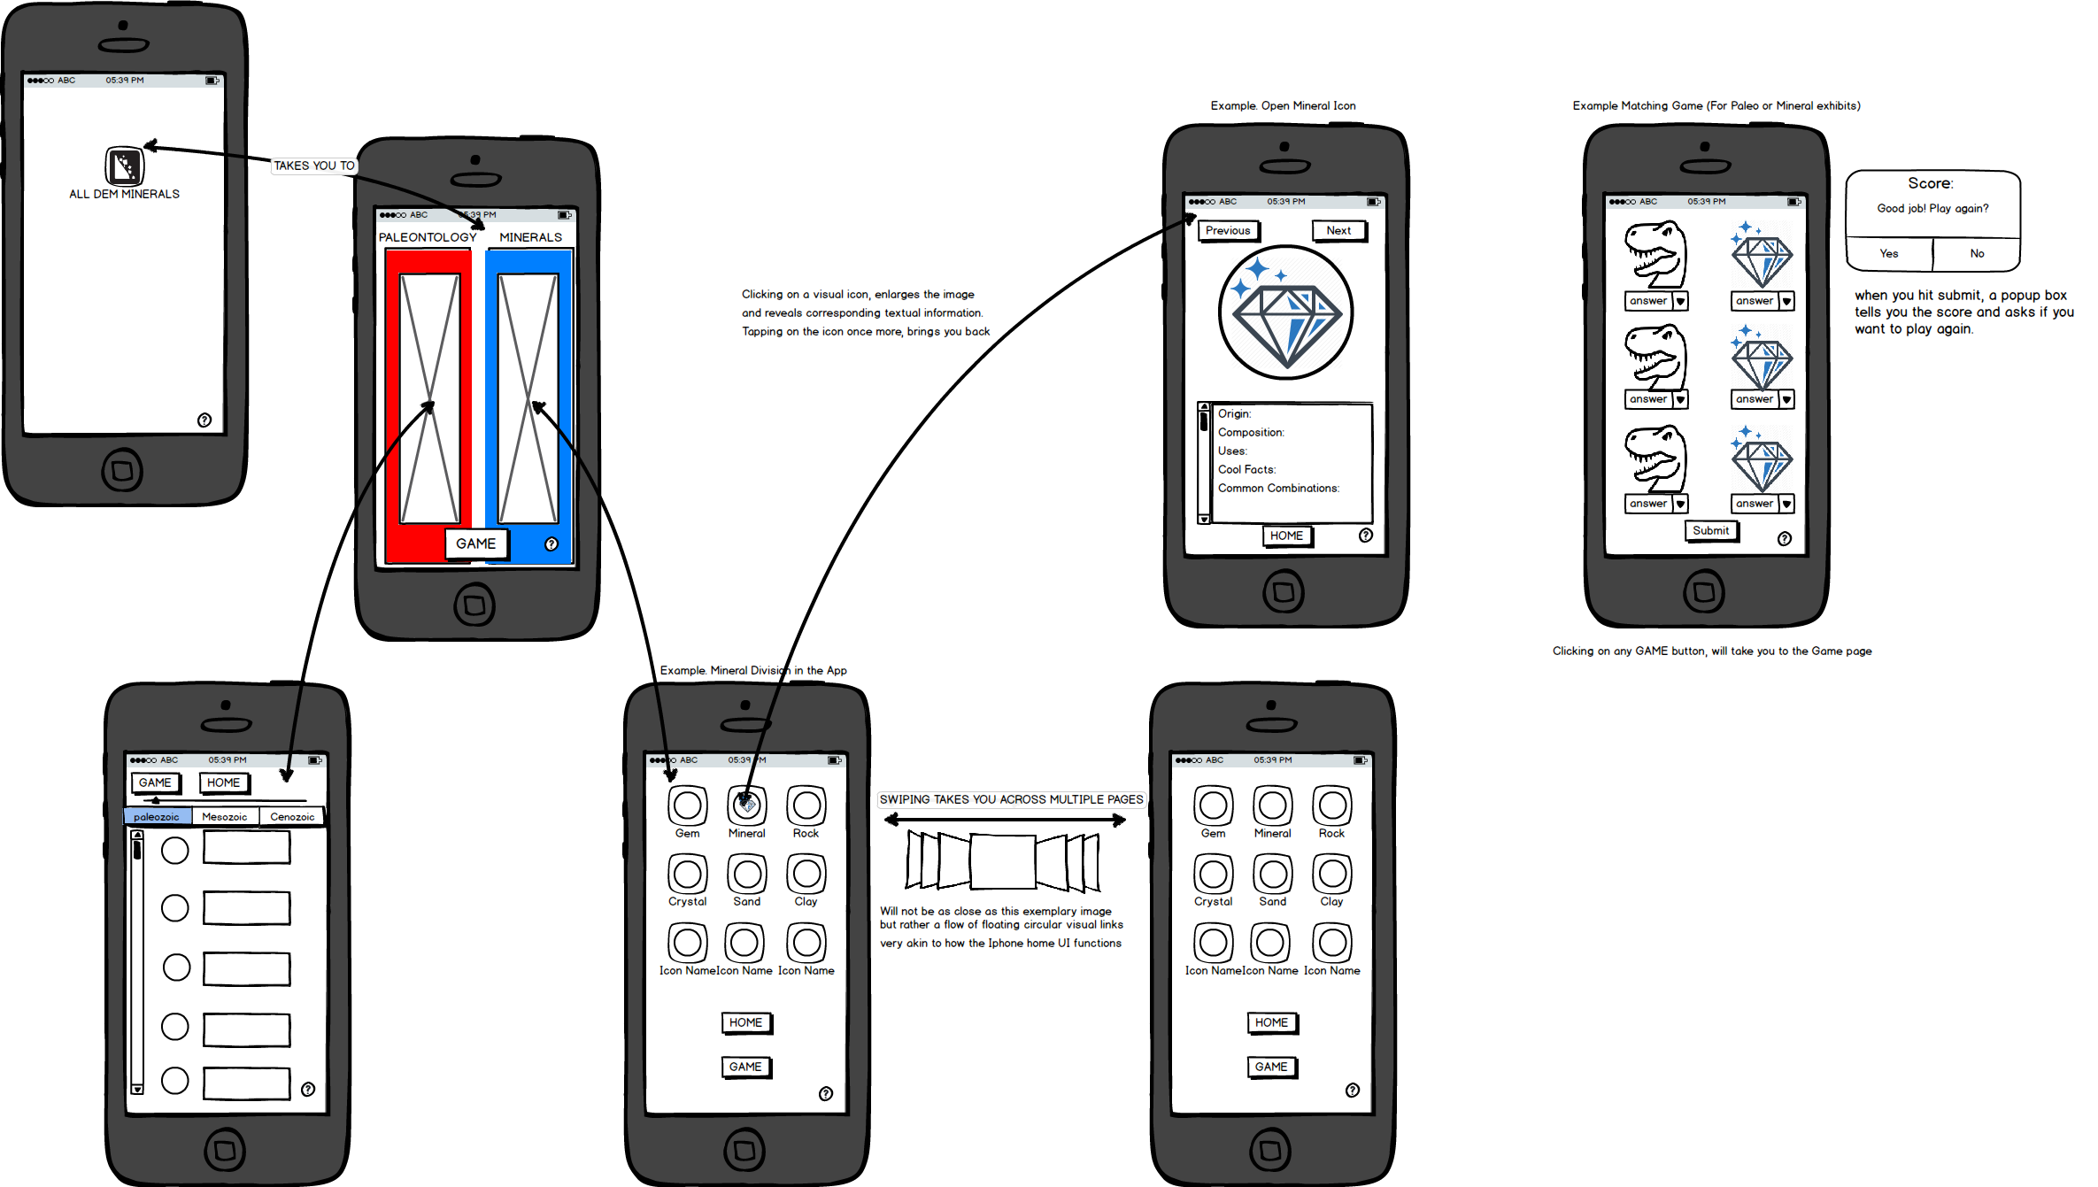

Slide 5
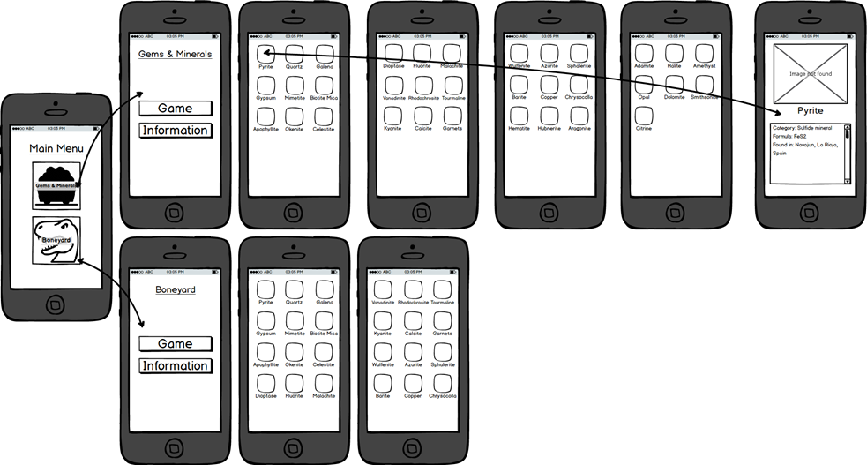

Slide 6
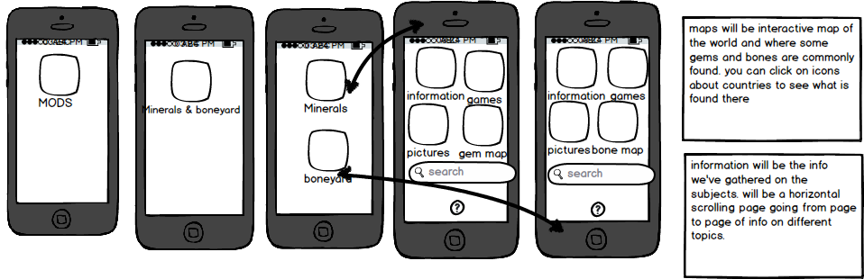

Slide 7
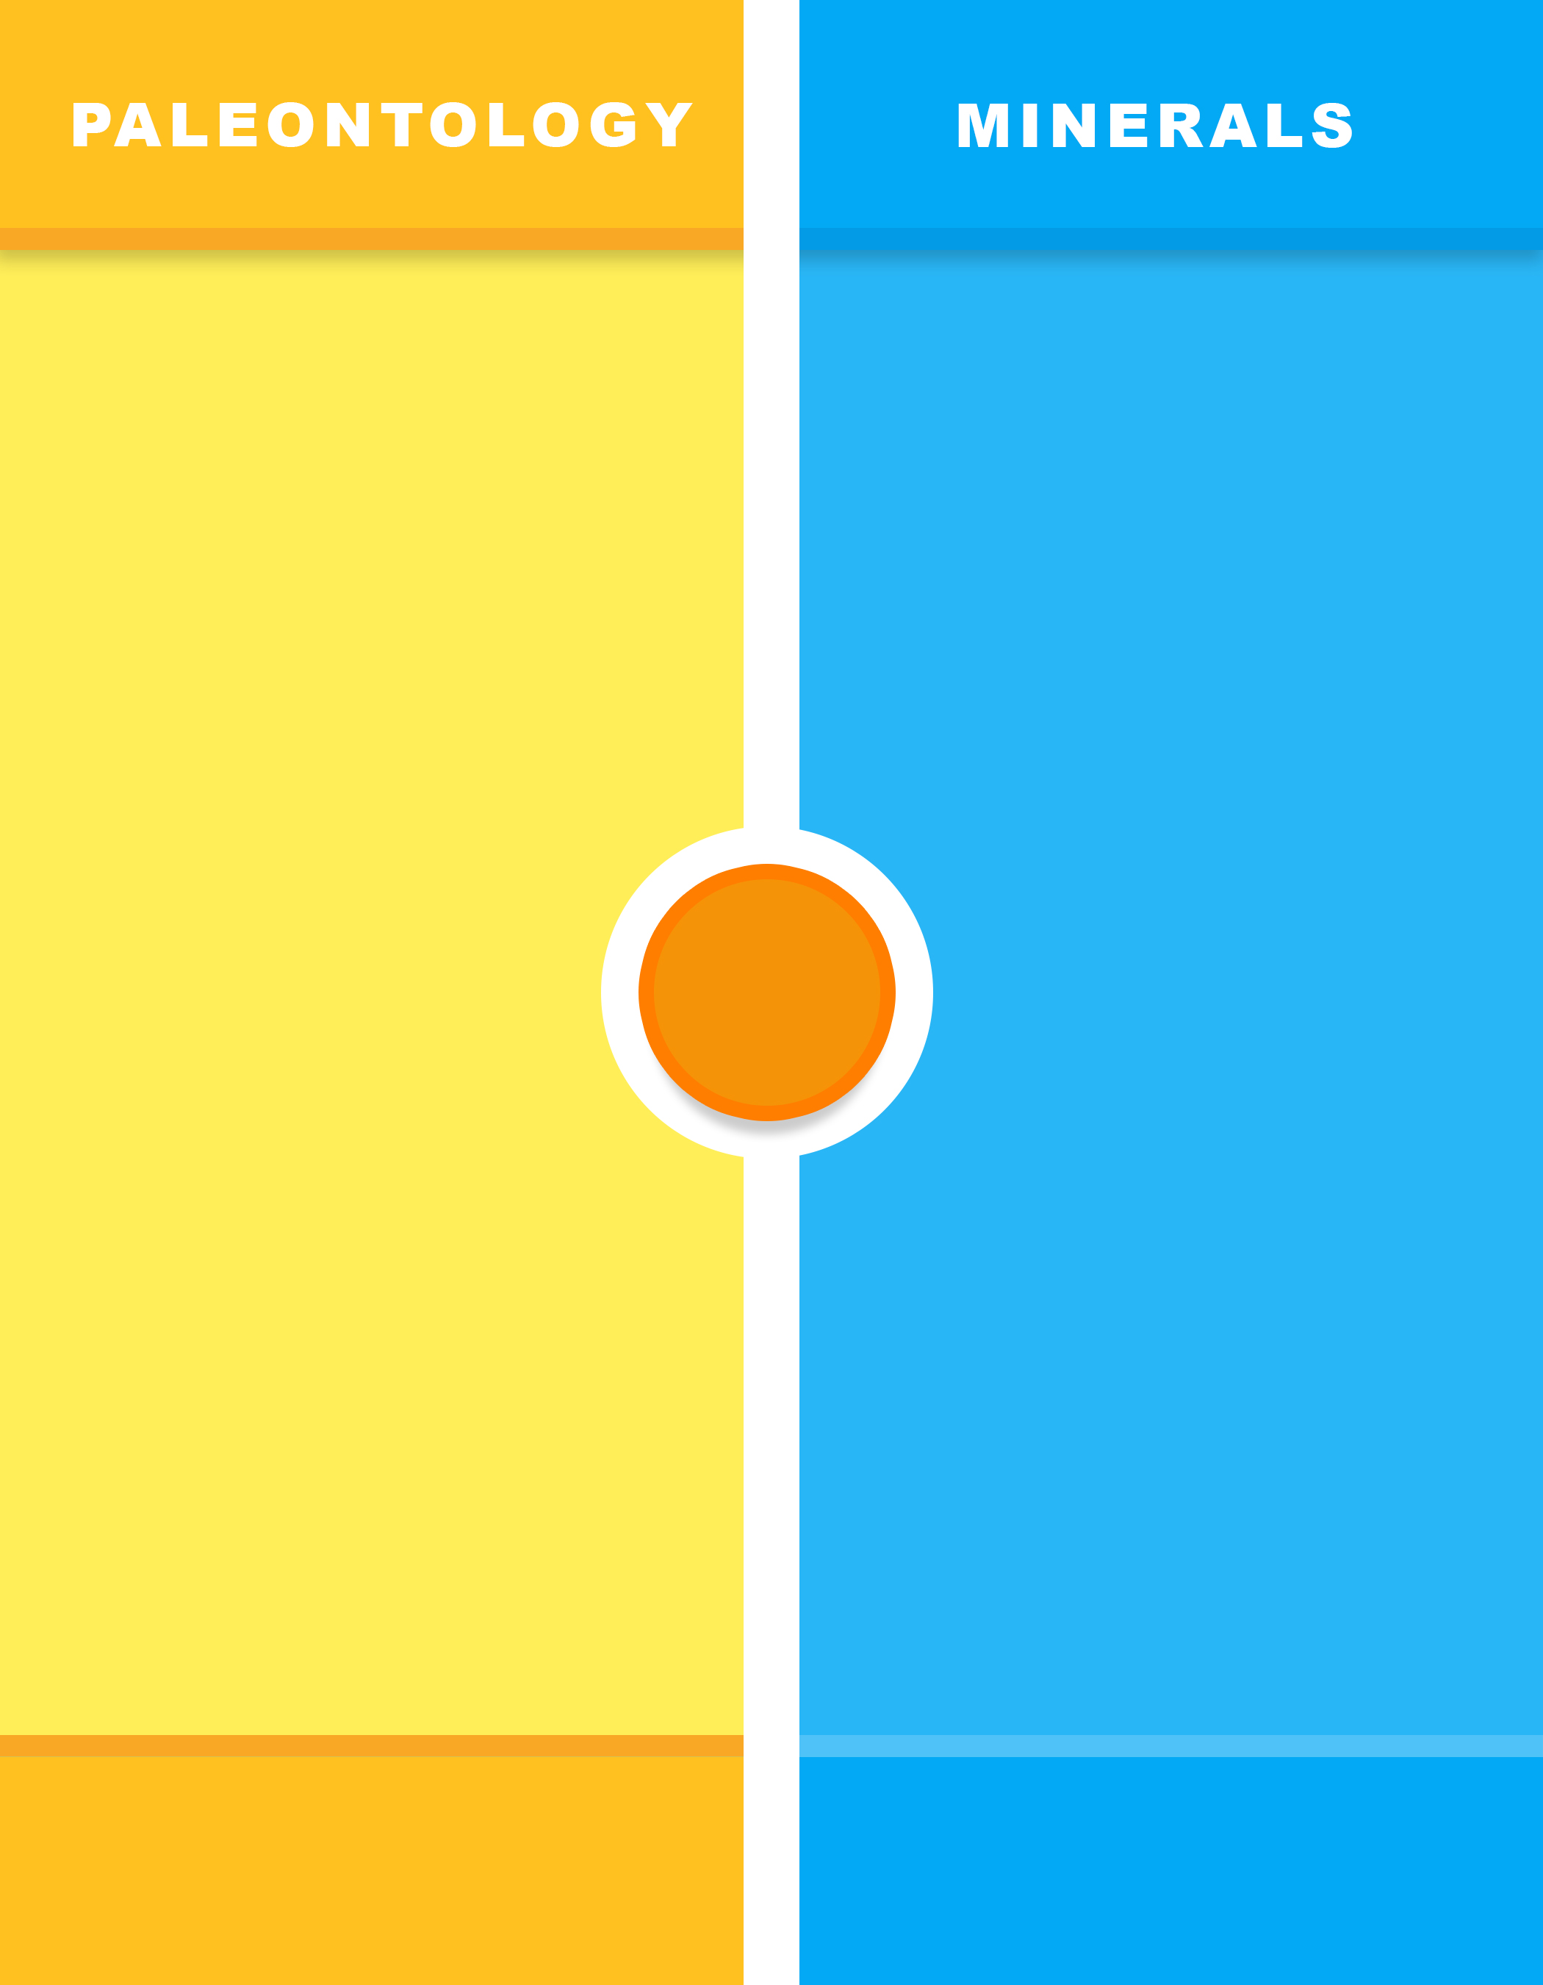
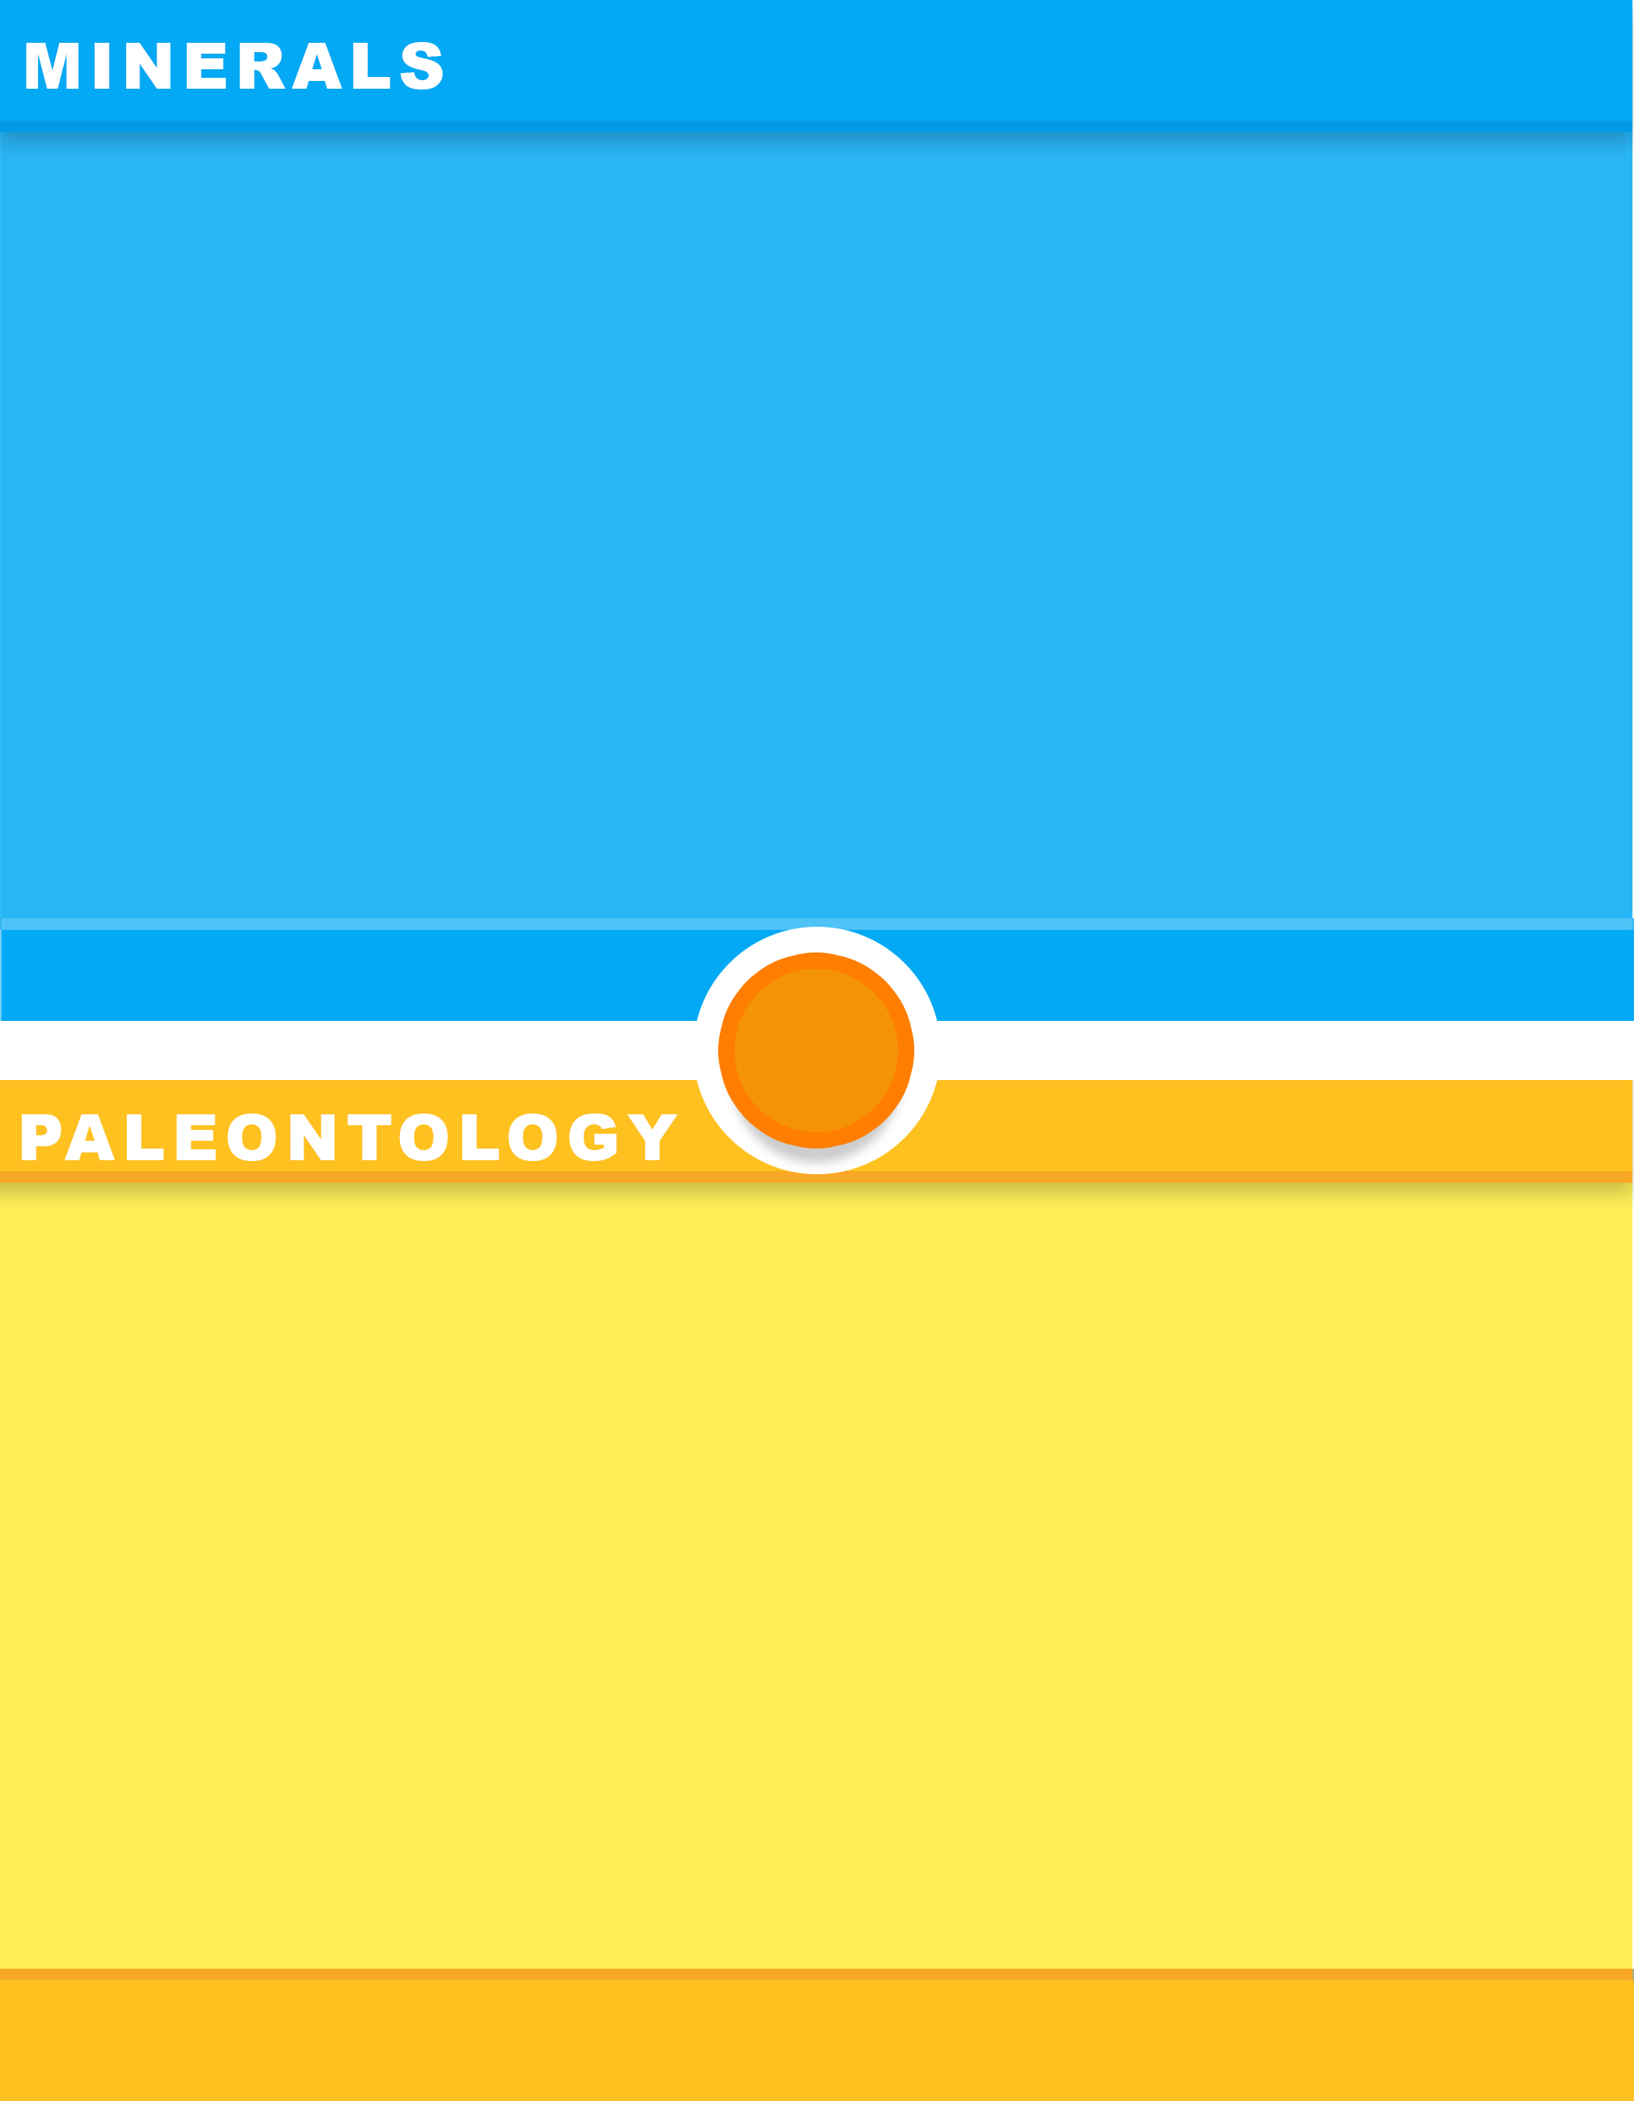
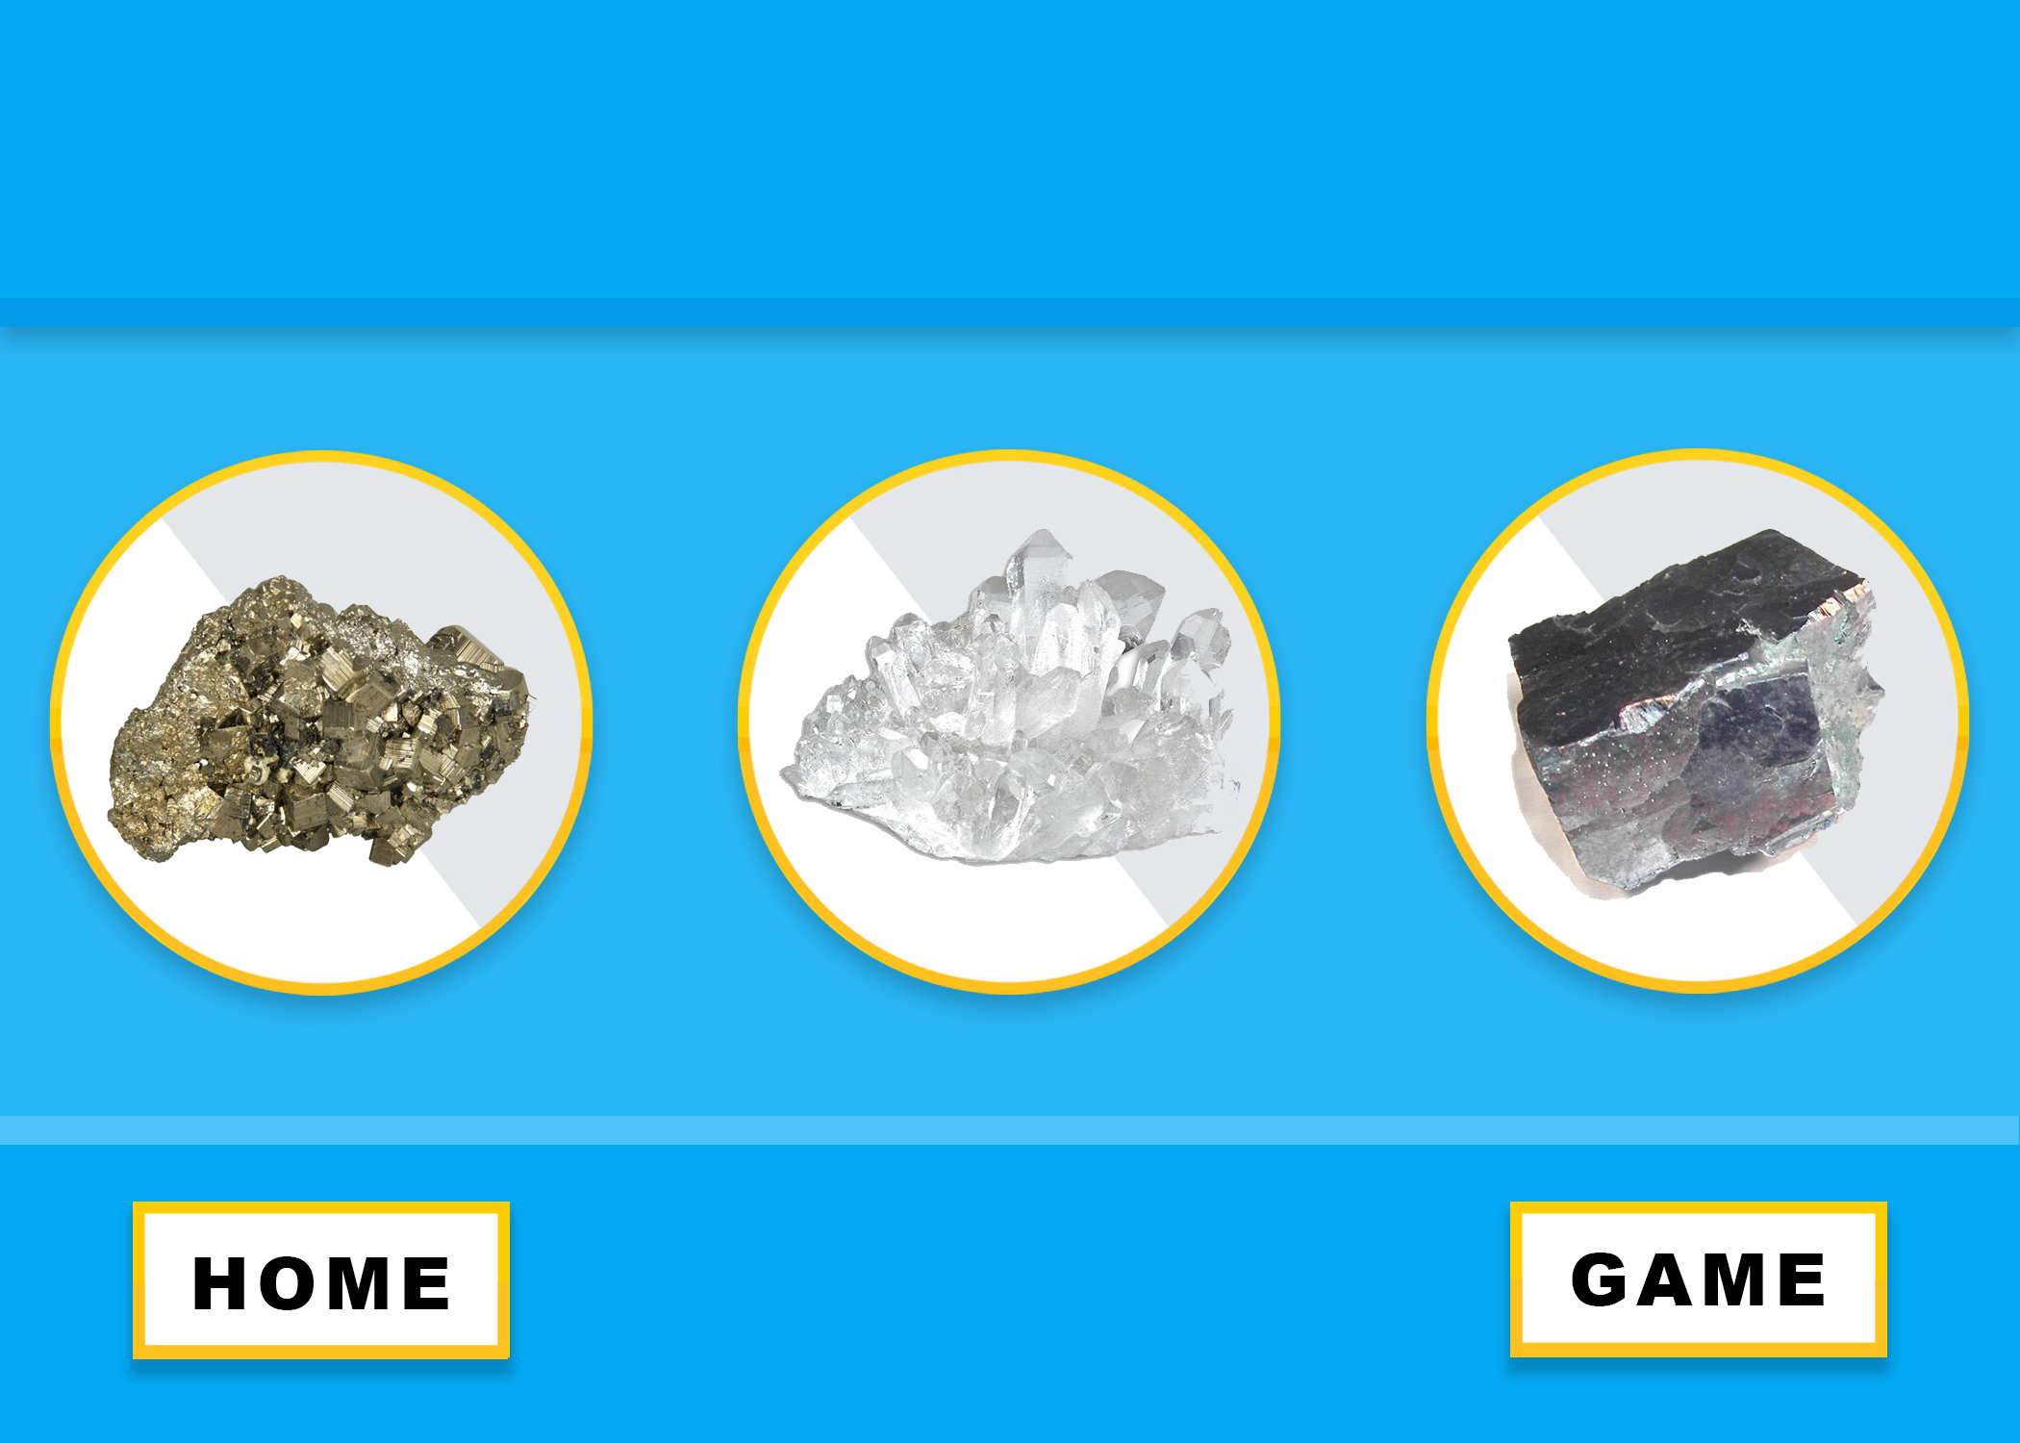
PLANNING

Slide 8


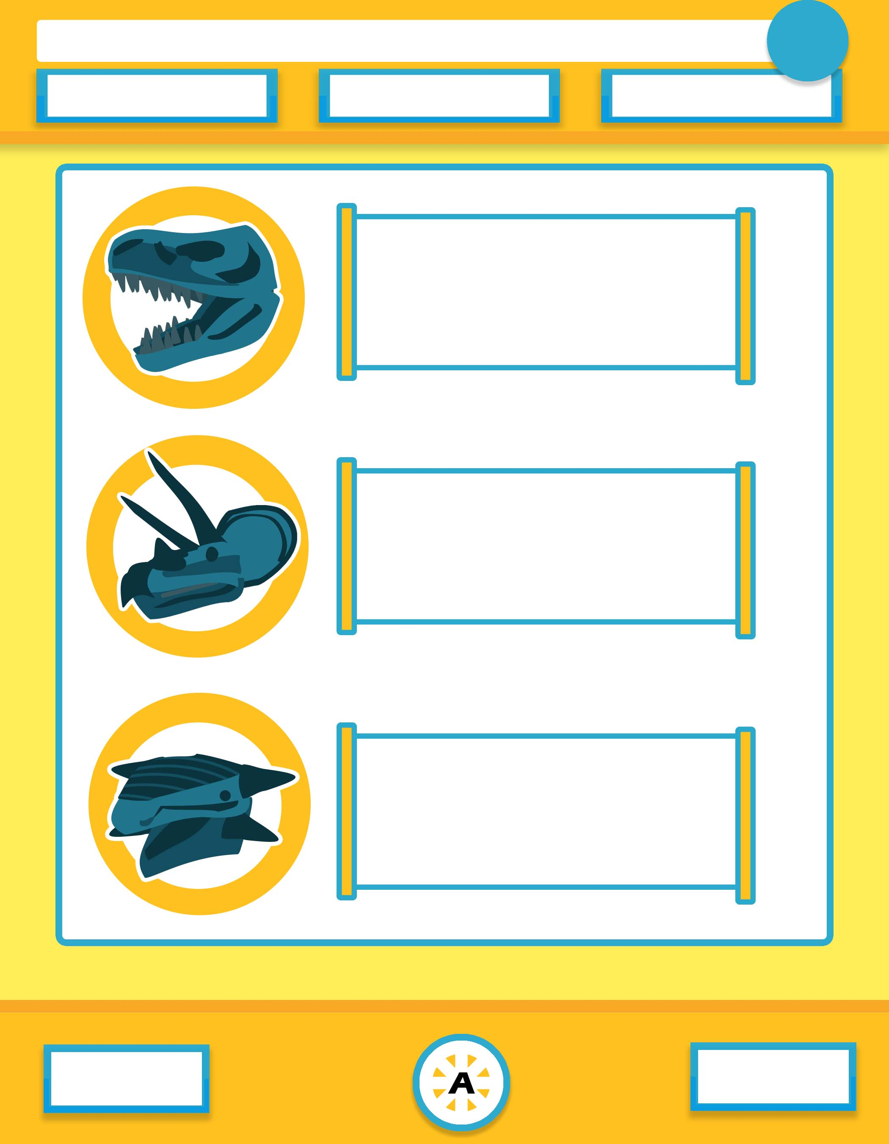
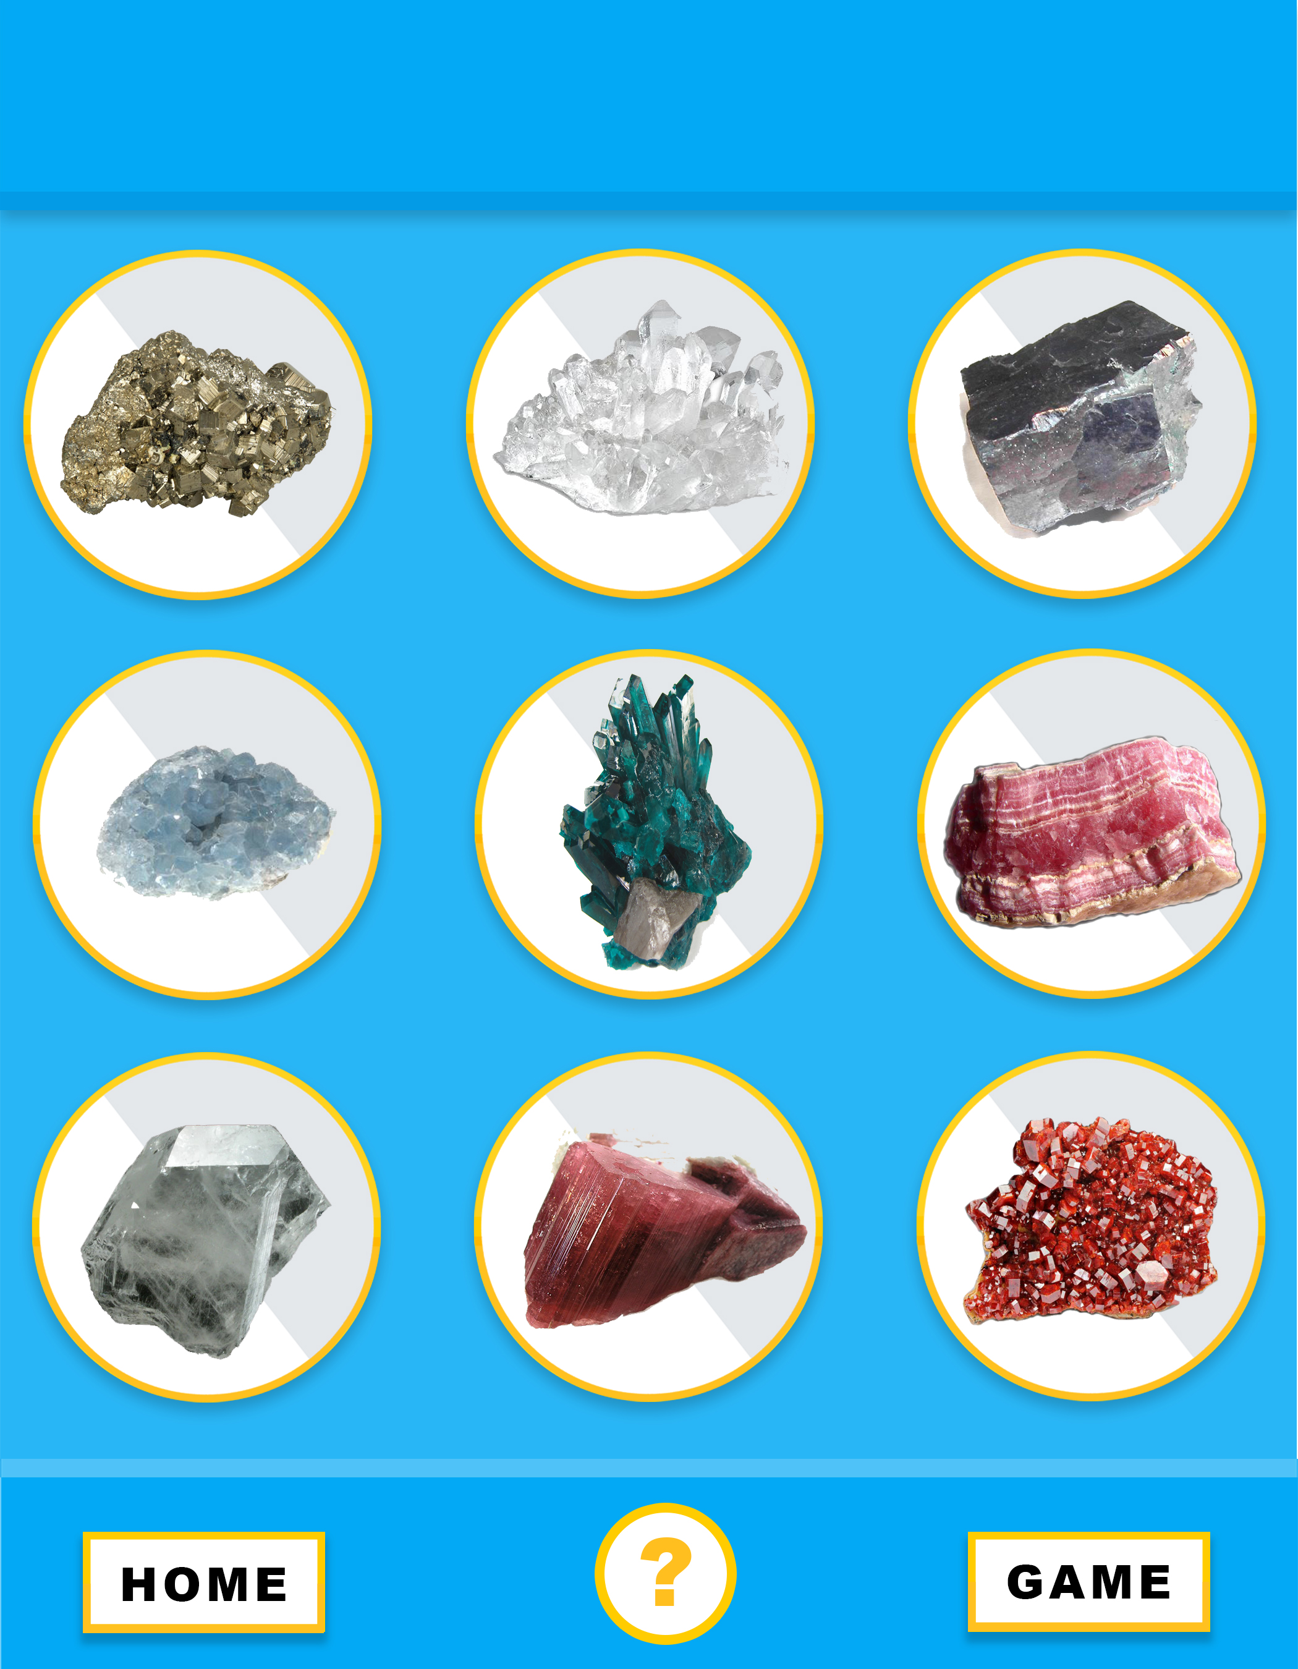






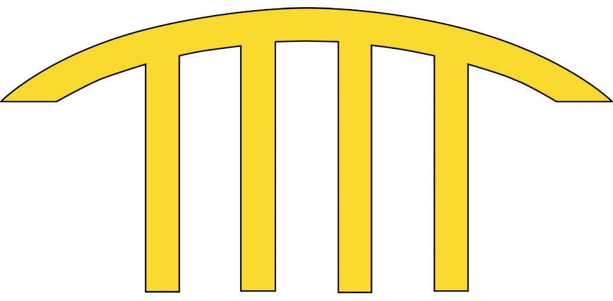
Examples of graphics & UI
As done by Savion M. and Piero S.
The majority of our graphics were designed and created in Photoshop

Slide 9
Credits and thanks to
Museum of Discovery & Science
Florida Atlantic University
Broward College
Google Design
Adobe
Android Studios
Online Databases
The English Language
All of you
Ancient Animals
Gems & Minerals
The Universe

